Slide 1
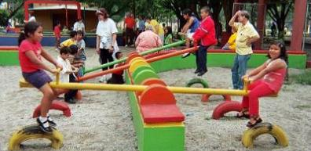
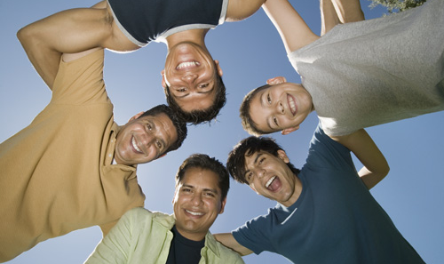


Framing the Issues:
Promoting Health Equity and Social Justice through Addressing Social Determinants, Health Inequities
Sheila Savannah, MA
Director, Prevention Institute
The College for Behavioral Health Leadership
San Diego, CA
April 6, 2015

Slide 2
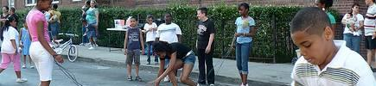
Health Equity
“Health equity means that every person, regardless of who they are—the color of their skin, their level of education, their gender or sexual identity, whether or not they have a disability, the job that they have, or the neighborhood that they live in—has an equal opportunity to achieve optimal health.”
Source: Braveman PA, et al. Health disparities and health equity: The issue is justice. 2011.
Notes:
EY
Our team used Paula Braveman’s definition of Health Equity as our starting point. “Health equity means that every person, regardless of who they are … has an equal opportunity to achieve optimal health.”

Slide 3
Determinants of Health (DOH)
Environment
  Social-Cultural Environment
  Built/Physical Environment
Housing
Public Safety
Education
Employment
Income & Wealth
Access to Quality Health Systems and Services
Notes:
SS
These are the determinants of health given to us by the Foundation.
They cover what we see in many community environments:
Lack of opportunities for physical activity
High alcohol outlet density and targeted marketing of single serving high alcohol beverages and tobacco
Pervasive violence as a pervasive part of a young person’s life
Saturation of low cost nutrient poor food in some communities
Culture of low expectations and socialization of boys of color into our criminal justice system
Lack of access to healthy air, water, and soil
Too many of our neighborhoods are killing the people that live in them and contribute to the leading causes of death, all of which are preventable
The AHE team’s prioritized DOH’s have well-documented connections to health and safety, illness and injury and inequities in health and well-being outcomes.

Slide 4

Findings about the Determinants of Health
Social-cultural Environment
Physical/Built
Environment
Housing
Public
Safety
Education
Income
&
Wealth
The determinants of health are interrelated and interconnected.
Notes:
SS:
READ SLIDE
We found that it is difficult to tease out one DOH from another

Slide 5
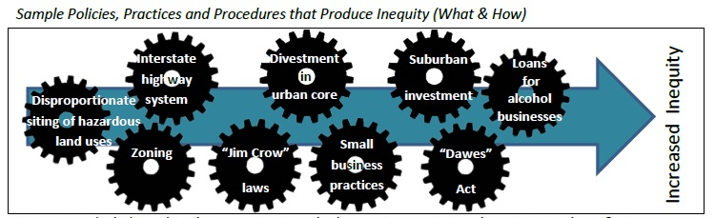
The Production of Inequities
Built/Physical Environment
Health inequities have been produced through policies, practices & procedures
Notes:
There are policies, practices and procedures – some deliberate, some inadvertent; some historical, some current day – enacted by and across sectors that have contributed to health disparities across racial/ethnic and socio-economic lines by shaping the determinants of health (DOH), which have well documented connections to health, safety, and health equity.
EY
We also found that policies, practices and procedures within each Determinate of Health has systematically produced inequities in health outcome along racial/ethnic and economic lines.
We used gears to visually demonstrate the notion of production and to show that these policies and practices are interrelated and exacerbate each other.
For example, it was wasn’t just investment in suburban infrastructure but also divestment of the urban core that intensified built environment inequities experienced by African American and Latino communities.
Looks at what the ppp are that contributed to inequities
Used gears as a metaphor – to demonstrate that these to understand that ine have beenproduced across r/e lines through a host of ppp and they tend to be interrelated and interact to exacerbate each other
We went through this exercise for each DOH – across each of these determinants we have produced inequities

Slide 6
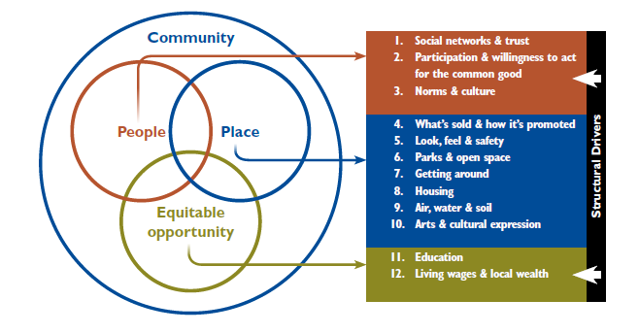
THRIVE Clusters and Factors
Notes:
GOAL: THRIVE provides an organizing framework to understand these community determinants, like Parks & Open Space
THRIVE is organized into three, interrelated clusters:
People (the social-cultural environment): People are healthier in neighborhoods where people feel connected and are empowered.
Place (the physical and built environment):The places where people live, work, and play directly impact behaviors, which in turn, shape health outcomes.
3) Equitable Opportunity (the economic and educational environment): Differences in access to resources and opportunity—and wealth--affect health and safety over a lifetime, and even into the next generation.
Together make up community determinants
The three clusters are comprised of twelve community level factors (See Figure 2).

Slide 7
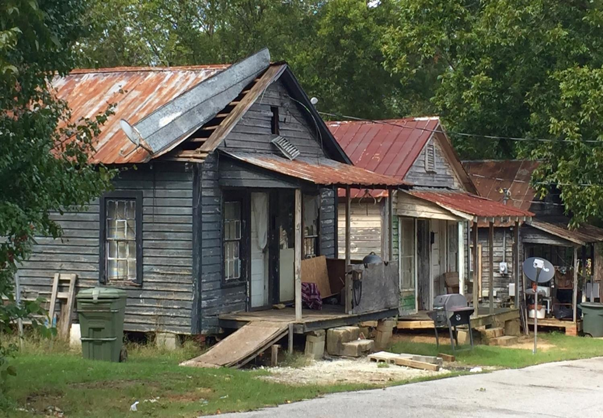
Florence, South Carolina
Notes:
“What’s Mental Wellbeing Got To Do With It?”
What do you see?
What does it have to do with mental wellbeing?
ALEXIS AND SHEILA dialogue for first example
For some slides in this segment, pause for audience answers.

Slide 8
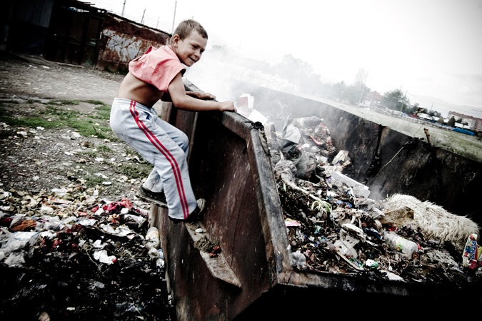
Photo credit: Livo Mancini/Redux

Slide 9
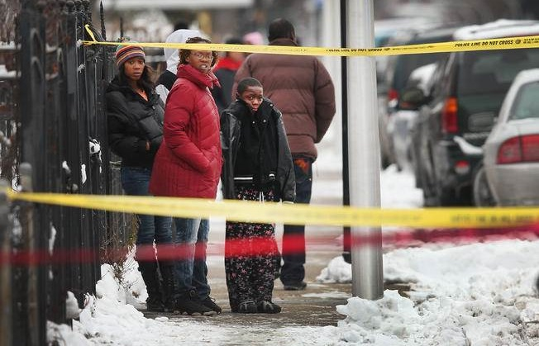
Chicago, Illinois

Slide 10
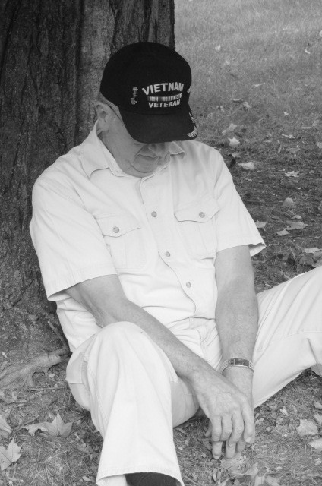
Canton, Connecticut
Notes:
Self-medicating isolated vet

Slide 11
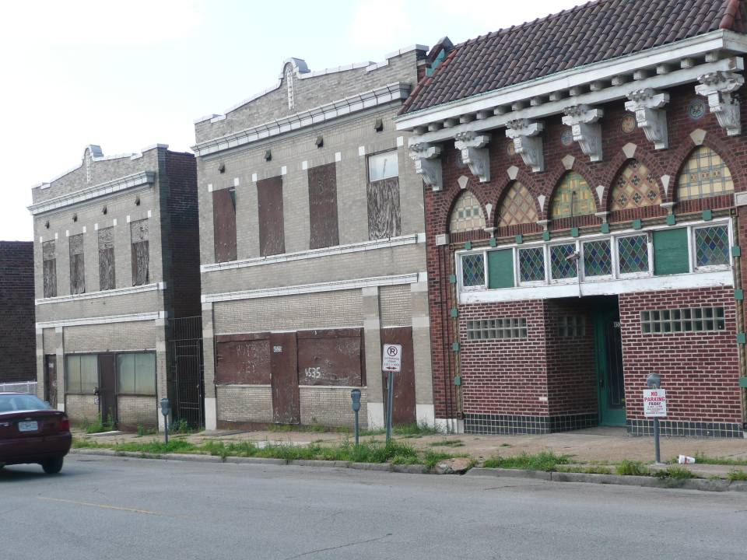

Slide 12
“
It is unreasonable to expect
that people will change their behavior easily when so many forces in the social, cultural and physical environment conspire
against such change.
— Institute of Medicine
”

Slide 13

Advocacy
Interface between Physical, Mental and Behavioral Health
Mental and Behavioral Health
Physical Health
Socio-Cultural Needs
Healthy Community Environments

Slide 14
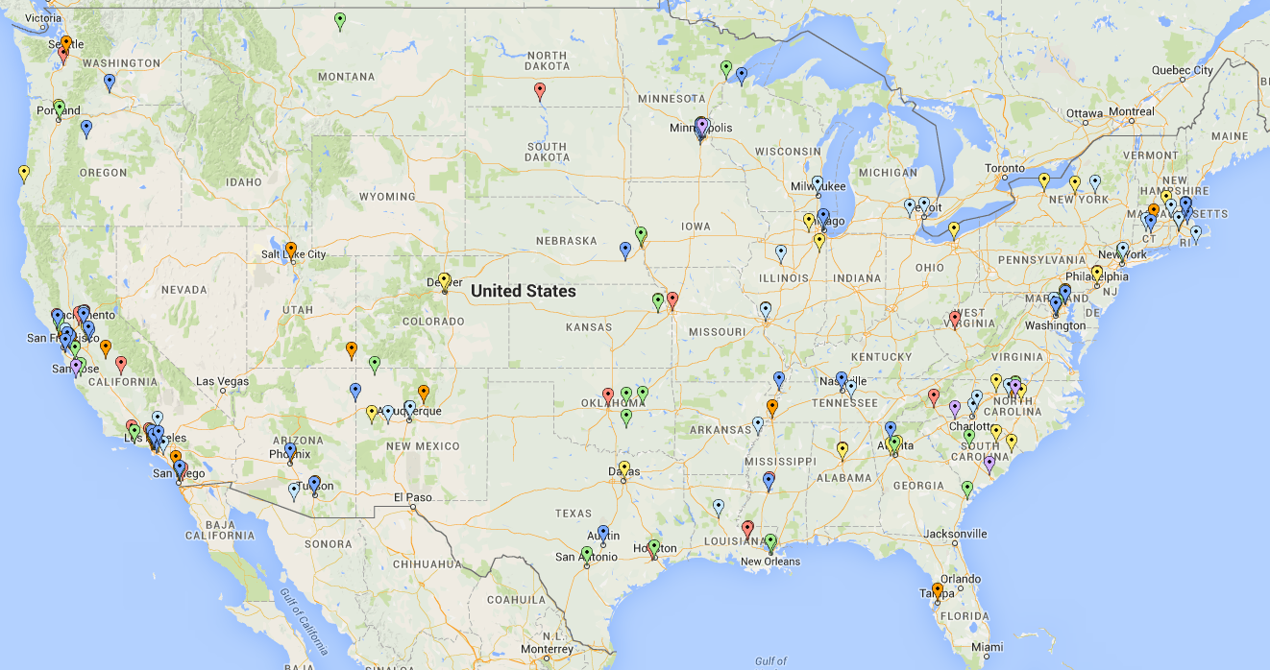
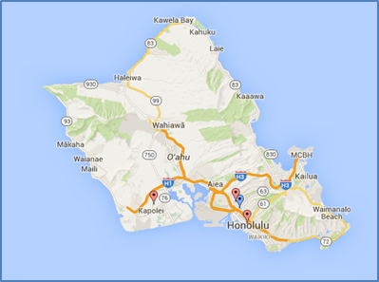
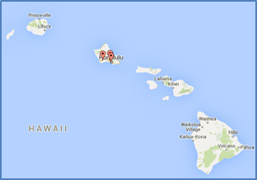

Making Connections
Notes:
Applications were received from organizations in 35 states and Washington, D.C. allowing for the selection of a geographically diverse cohort.
Over 225 responses received; Representation from 35 states and Washington, D.C.
With each site identifying at least 5 partner organizations
Types of organizations:
40 city, state, county govt
8 faith-based
21 institutions of higher ed
8 Native American Tribal Govt
6 Native American Tribal Org
150 nonprofits with 501c3 status
14 minority serving org
6 military and vet serving org
4 for-profit org/small business
Applying and partnering –
Part of the public health system vs public health agencies
Pop of focus:
189 boys of color
187 men of color
38 military
67 veterans
125 families/fathers
51 immigrants
33 tribal

Slide 15
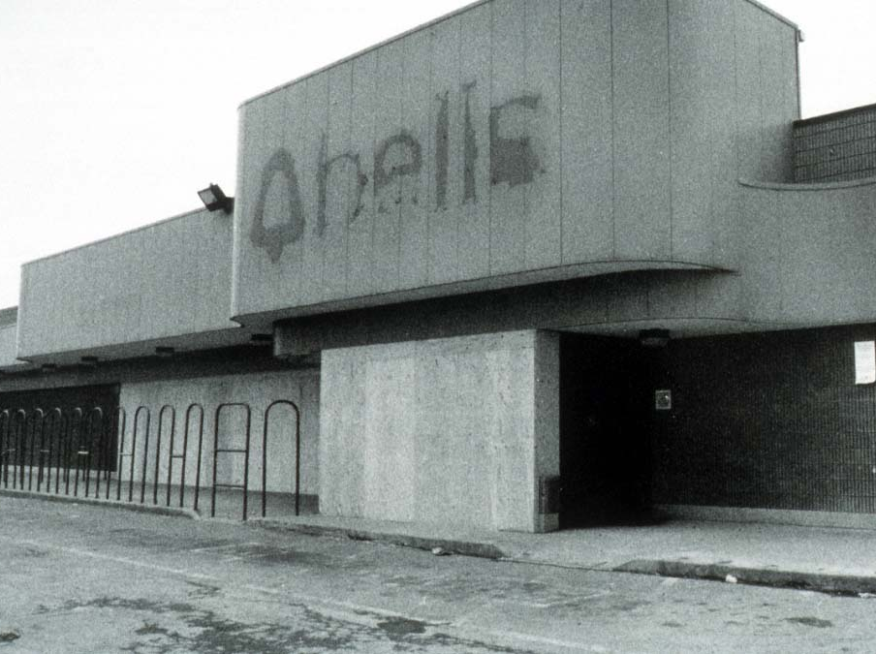
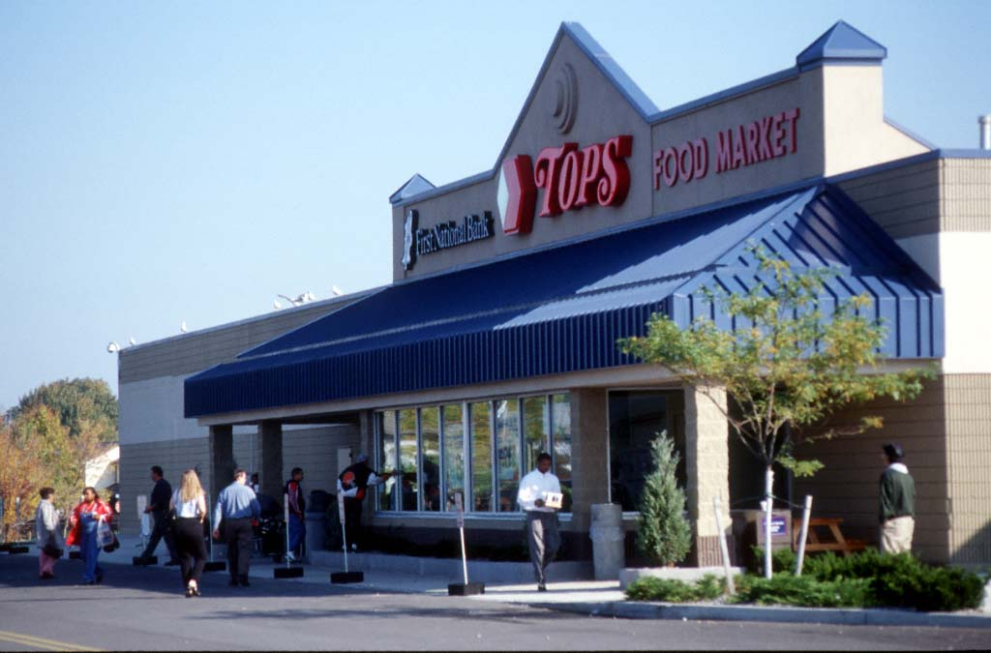
What’s Sold & How It’s Promoted
Health Equity by Design
Increasing Access to Healthy Foods
Rochester, NY
Notes:
EY
Here we have that previously abandoned supermarket transformed making sure that healthy food is available and easily accessible in all our communities.

Slide 16
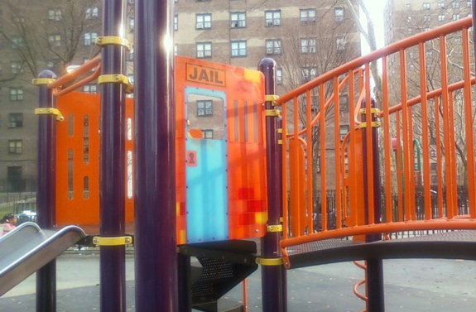
Photo credit: Adams IV. TheodorAkis for News
Notes:
http://www.nydailynews.com/new-york/brooklyn/city-paints-brooklyn-jail-playground-space-age-replacement-article-1.165345
Brooklyn's notorious jail playground has been sent to a galaxy far, far away.
Workers on Thursday removed part of a prison-themed jungle gym in a Bedford-Stuyvesant housing project and replaced it with with new space-age one.
"This is way better than the jail cell," said John Baez, a 39-year-old engineer who was playing with his 2-year-old daughter Thursday on the new equipment at the Tompkins Houses.
"The new image is showing you should discover, explore and find new horizons," he added. "It's a lot more positive."
The move comes after the original design - which featured the word "JAIL," painted bars and an exaggerated lock - sparked outrage from tenants and activists who charged it sent the wrong message to youngsters.
After the gaffe made headlines last month, some tenants at the violence-racked housing project demanded the entire bright-orange jungle gym be removed.

Slide 17
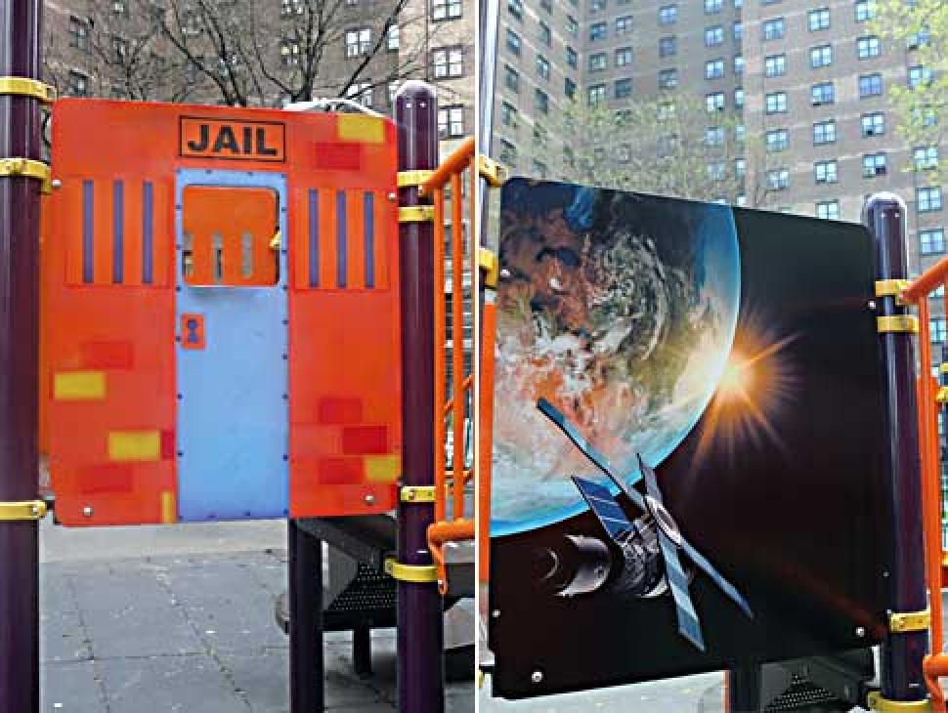
BEFORE
AFTER
Photo credit: Adams IV. TheodorAkis for News
Notes:
http://www.nydailynews.com/new-york/brooklyn/city-paints-brooklyn-jail-playground-space-age-replacement-article-1.165345
Brooklyn's notorious jail playground has been sent to a galaxy far, far away.
Workers on Thursday removed part of a prison-themed jungle gym in a Bedford-Stuyvesant housing project and replaced it with with new space-age one.
"This is way better than the jail cell," said John Baez, a 39-year-old engineer who was playing with his 2-year-old daughter Thursday on the new equipment at the Tompkins Houses.
"The new image is showing you should discover, explore and find new horizons," he added. "It's a lot more positive."
The move comes after the original design - which featured the word "JAIL," painted bars and an exaggerated lock - sparked outrage from tenants and activists who charged it sent the wrong message to youngsters.
After the gaffe made headlines last month, some tenants at the violence-racked housing project demanded the entire bright-orange jungle gym be removed.

Slide 18
P is for Progress:
Toward a System of Health Equity
Purpose: Intentionality for Health Equity
People: Leadership and Engagement
Practice: Methodology and Capacity
Platform: Infrastructure to Support Success
Notes:
SS
The System of Health Equity has four pillars:
READ SLIDE

Slide 19
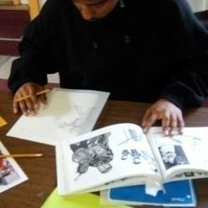


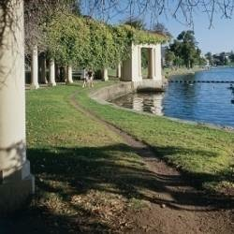
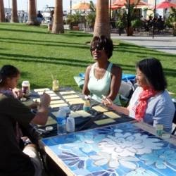
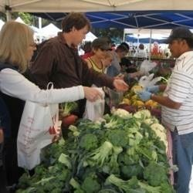

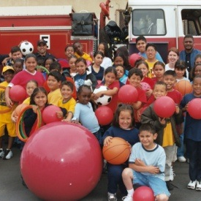


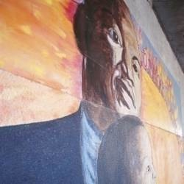
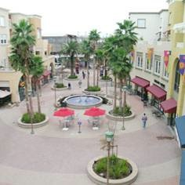
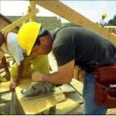
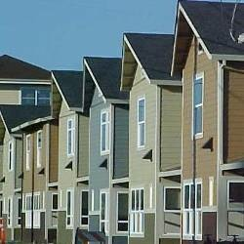

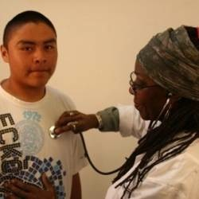
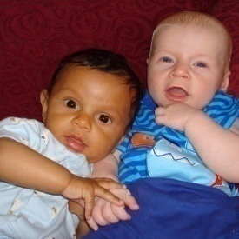
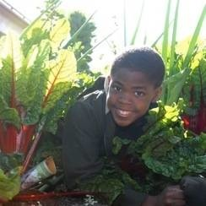
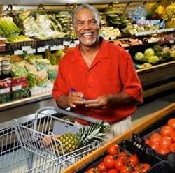
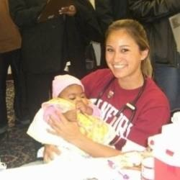
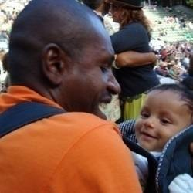
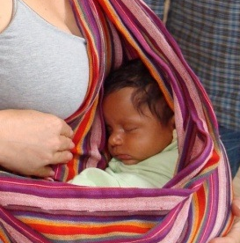
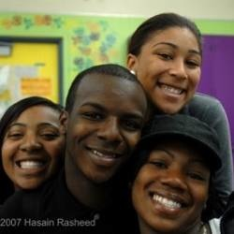
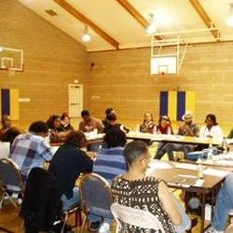
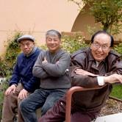
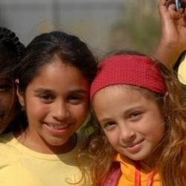
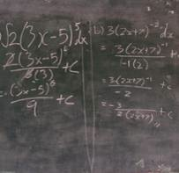
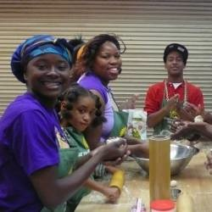
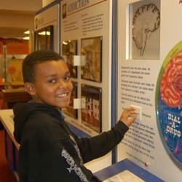
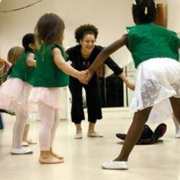
Economics
Medical Care
Childcare
Jobs
Healthy Food
Clean Air
We each
have a role
Parks and Activities
Policy Makers
Safe Neighbor-hoods
Education
Housing
Behavioral
Health
Transport-ation
Residents
Notes:
Violence is preventable and we each have a role to play. Violence can be prevented by addressing the interplay of risk and resilience factors at the community, neighborhood, relationship, and individual levels.

Slide 20
The Role of Behavioral Health
Promoting health equity and social justice
Partnerships to advance equity
Individual → Community → Policy
Advocacy
Clinical Practice
Prevention
Lead the dialogue – Shift the paradigm

Slide 21

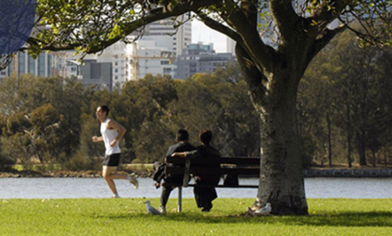



www.preventioninstitute.org
221 Oak Street
Oakland, CA 94607
Tel: (510) 444-7738
Follow us on:
Sign up for our media alerts:
http://www.preventioninstitute.org/alerts

